Slide 1
PHARMA RETAIL STORE SALES PREDICTION
Project 6
Submitted by –Ajit Kumar

Slide 2
Project Overview
Business Context-
As a Machine Learning Engineer at NextHikes, you are tasked with a sales forecasting project for Rossmann Pharmaceuticals. The finance team aims to predict sales across all stores in various cities, six weeks in advance. Historically, sales forecasting relied on managerial experience and judgment. Your objective is to deliver an end-to-end predictive solution to help the finance team plan effectively. .
Data Context:
The dataset includes various factors affecting sales, such as promotions, competition, holidays, seasonality, and store locality. A complete list of fields includes sales, store characteristics, holiday indicators, promotions, and competitor data.
Project Goals:
Analyze customer purchasing behavior.
Predict daily sales up to six weeks ahead.
Use machine learning and deep learning approaches for forecasting.
Deploy a web-based tool to serve predictions to finance analysts.
Learning Objectives
Participants will gain:
Technical Skills: Pandas, Numpy, Matplotlib, HTML, CSS, Flask, TensorFlow, or PyTorch.
Feature Engineering: Generating and using new features.
Model Development: Building, fine-tuning, and serving predictive models.
Deployment Experience: Serving predictions via a web interface.

Slide 3
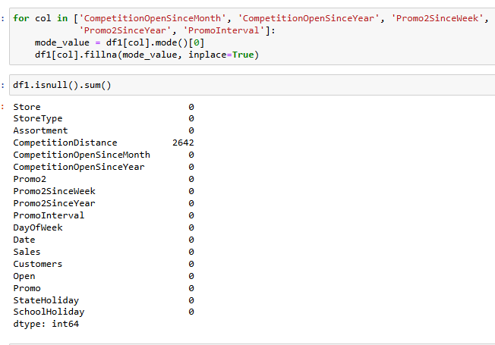
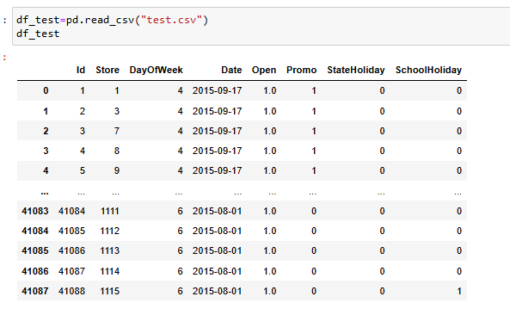
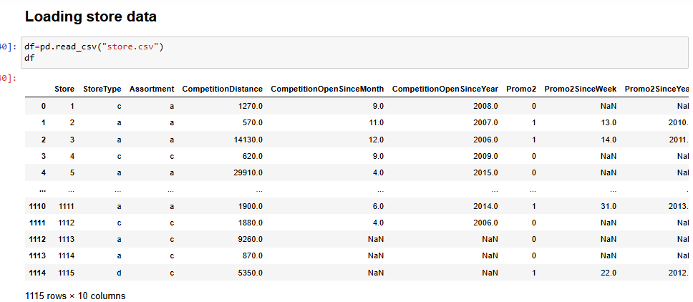

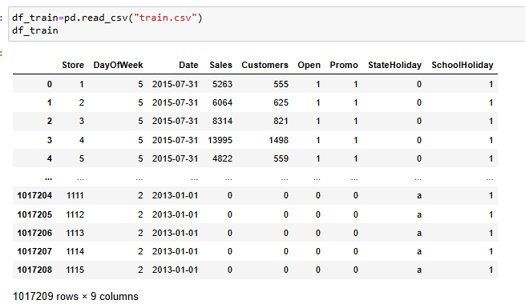
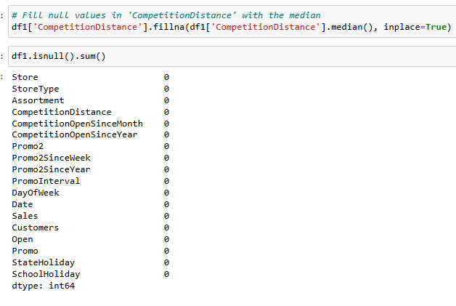
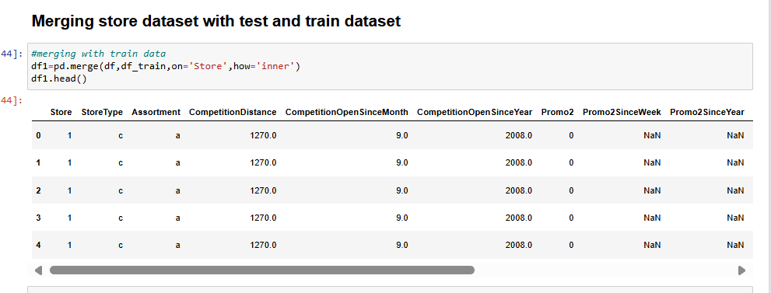
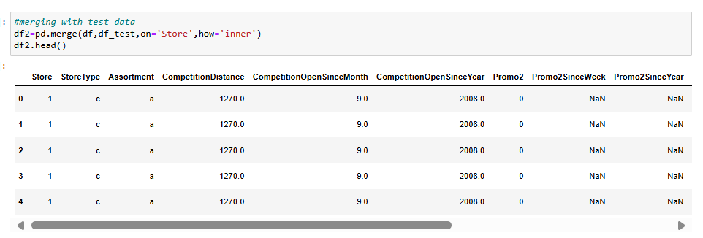
Data loading and preprocessing

Slide 4
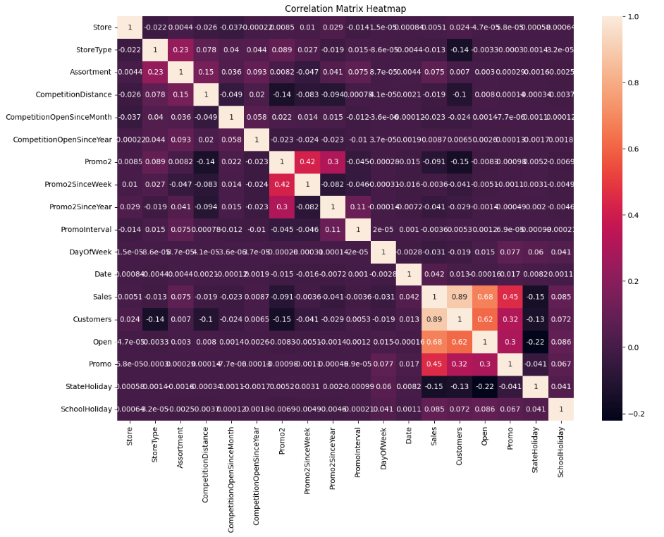
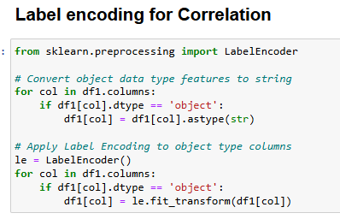
Correlation
Analysis
“Customers” and “Open” have correlation more than 0.5
Customers - 0.89
Open -0.62
“While Promo” is moderately correlated to Sales

Slide 5
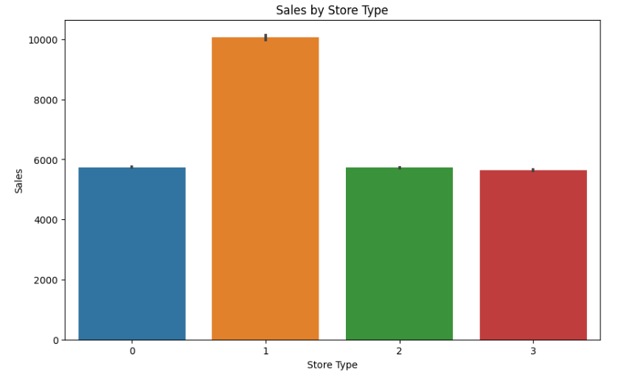
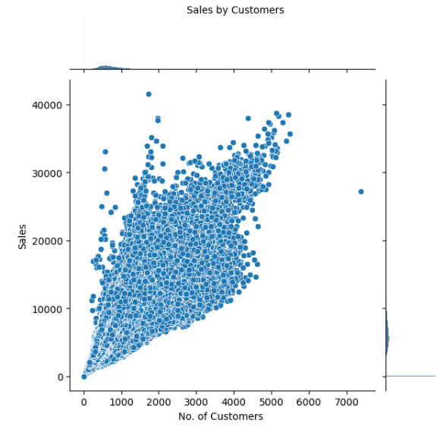
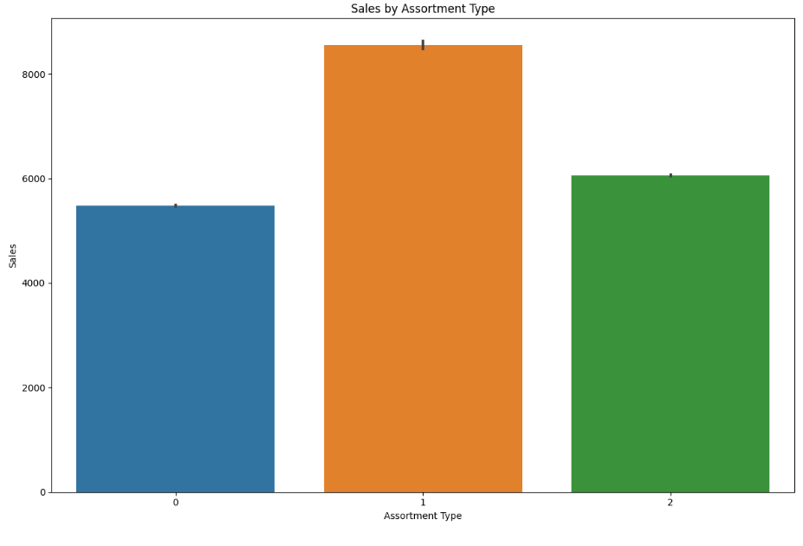
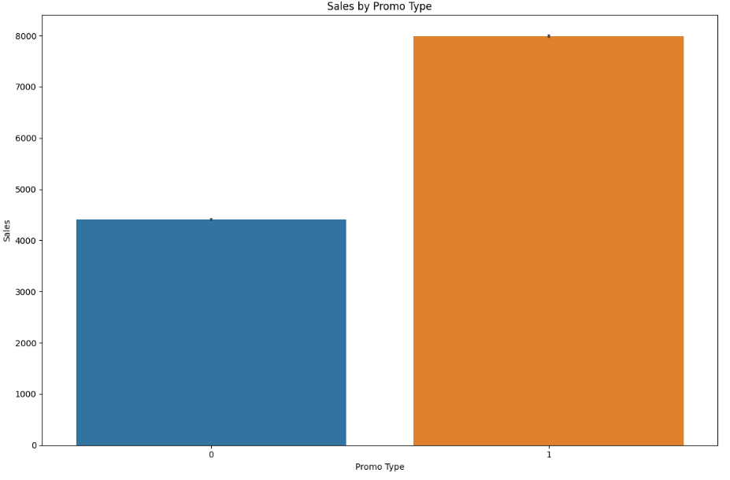
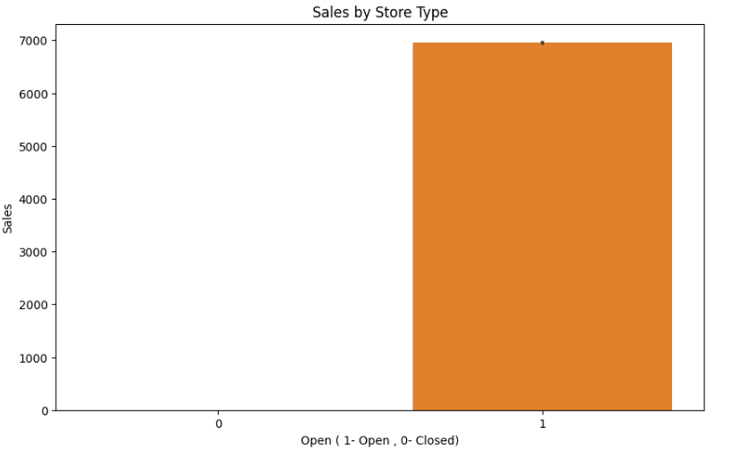
Sales by different parameters
Analysis-
Store type 1 and assortment type 1 store has highest numbers of sales.
Promo type 1 has the highest sales
No. of customers have linear relation with total sales. More the customers more the sales.

Slide 6
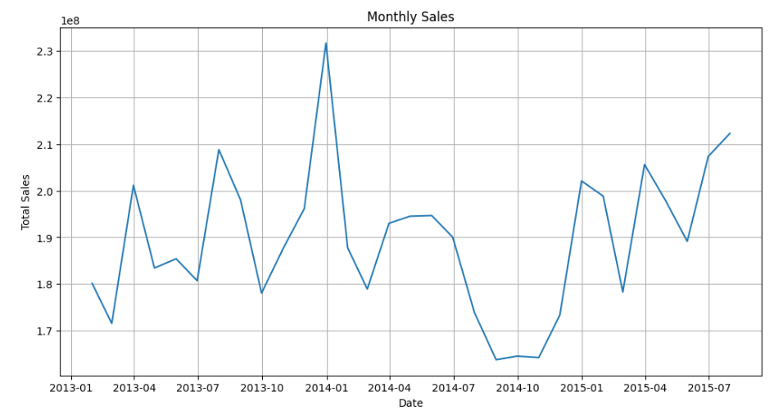
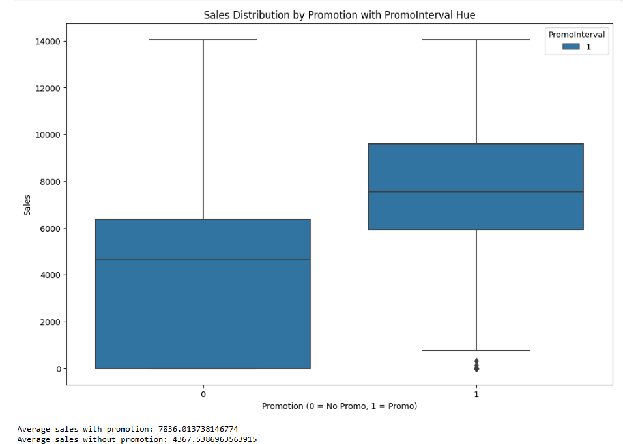
Customer purchase behaviour
Analysis-
Year 2014-01 witnessed highest sales while 2014-10 saw dip in the sales.
Promo has positive impact on sales while without promo has less sale
Analysis-
Average sales with promotion - 7836.013738146774
Average sales without promotion - 4367.5386963563915

Slide 7
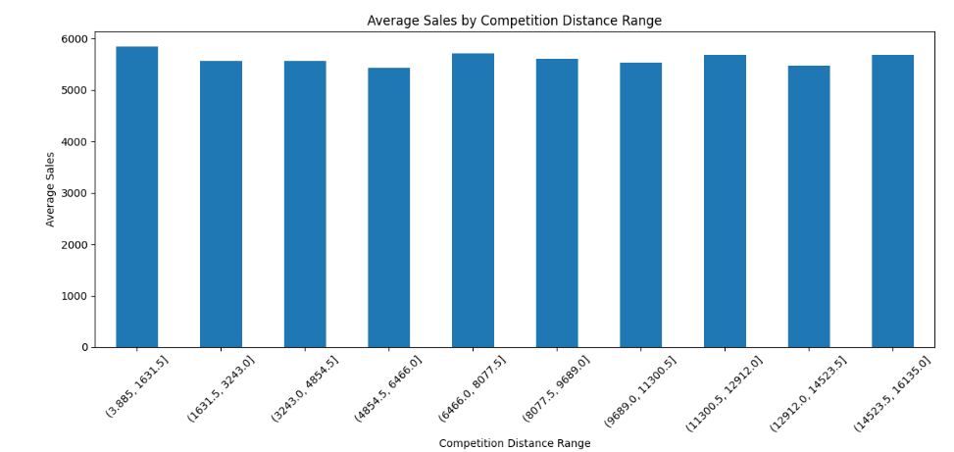
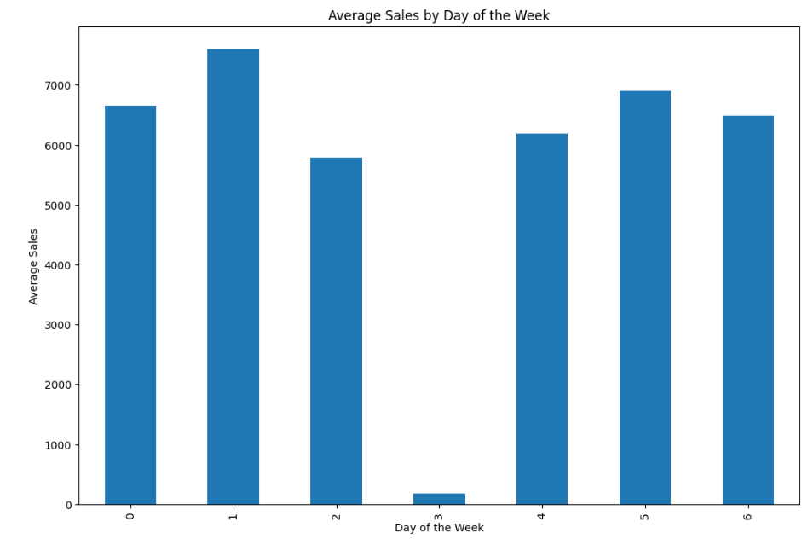
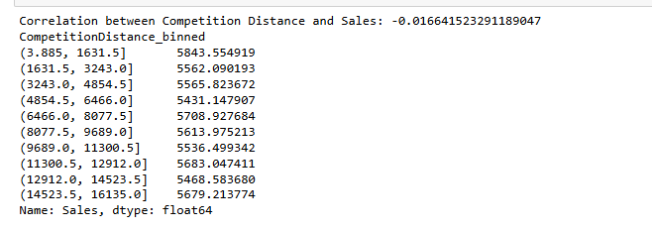
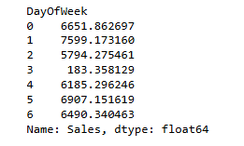
Sale analysis by distance and day of the week
Analysis-
Wednesday has the lowest sales as compared to others week day.
All locations has more or less similar sales

Slide 8
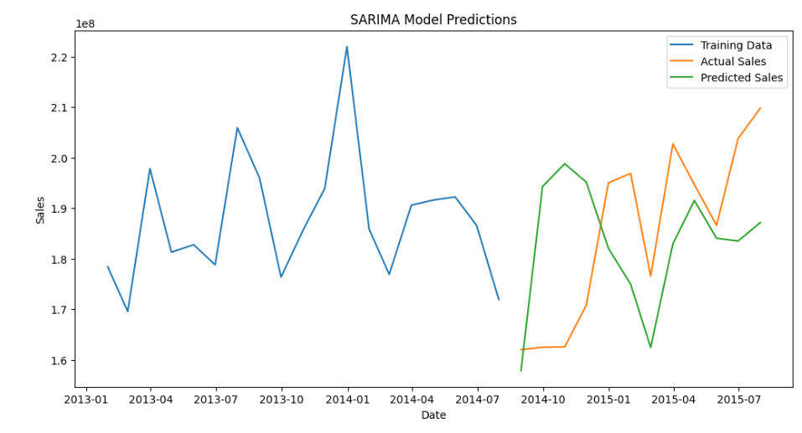
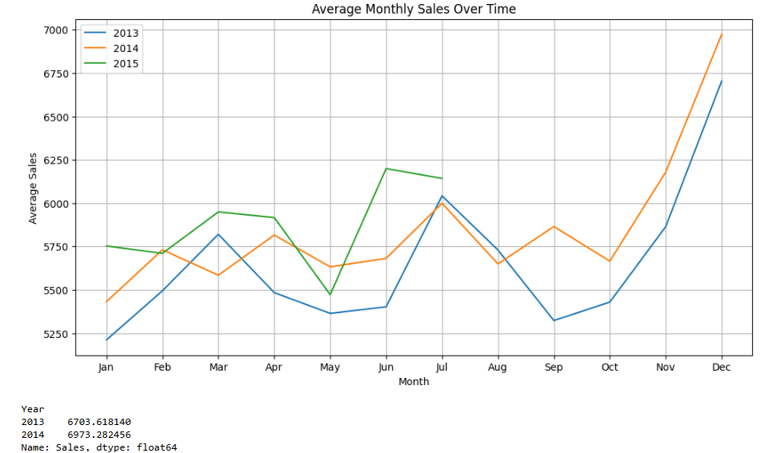
SARIMA model for prediction
Analysis-
SARIMA model is used to train the data set on quarterly basis.
Its used in time series data for forecasting with seasonal patterns
It captures both short term and long term dependencies
RMSE was found as 2656.92 using ARIMA model.
Analysis-
Store opening has substantial impact on sales.
Dec ,Nov and Oct have highest sales compared to other months.

Slide 9
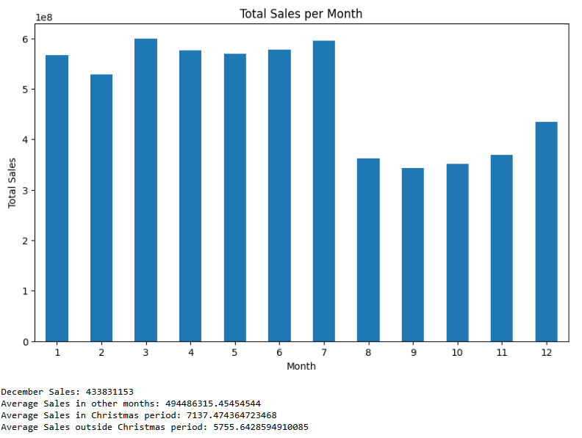
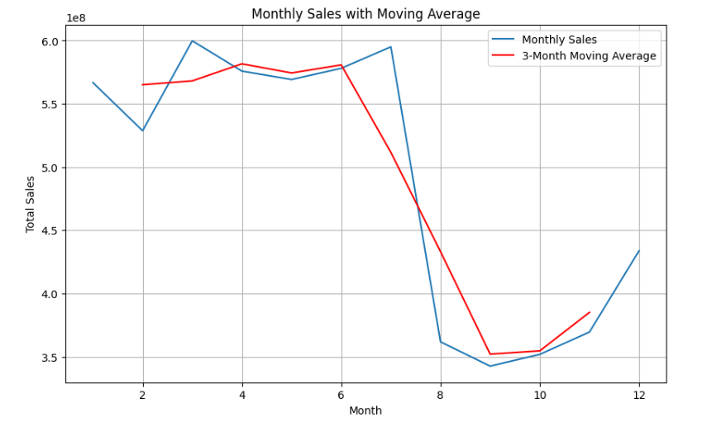
Monthly sales
Analysis-
December Sales: 433831153
Average Sales in other months: 494486315.45454544
Average Sales in Christmas period: 7137.474364723468
Average Sales outside Christmas period: 5755.6428594910085.

Slide 10
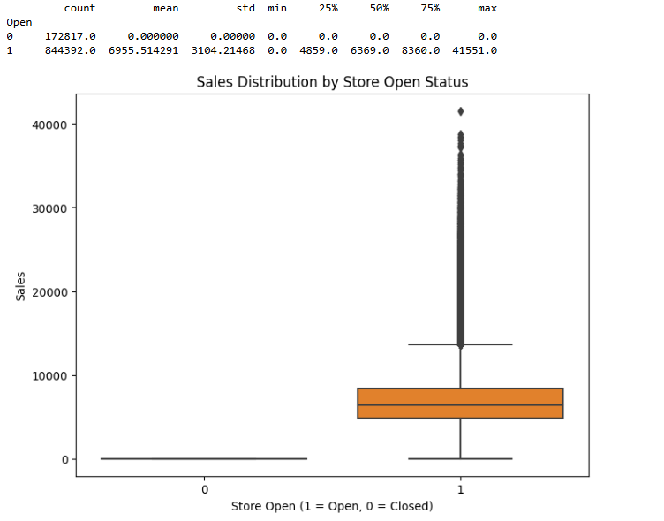
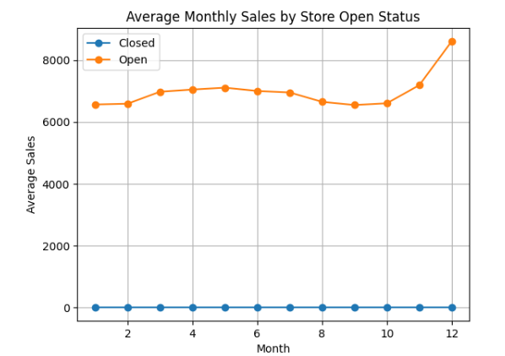
Sales by store open
Analysis-
December Sales: 433831153
Average Sales in other months: 494486315.45454544
Average Sales in Christmas period: 7137.474364723468
Average Sales outside Christmas period: 5755.6428594910085.

Slide 11
THANK YOU !

